Slide 1
Recipe Book Web App
HTML, CSS, JavaScript Project Overview

Slide 2

Project Features
Add, view, and search recipes
Each recipe includes name, ingredients, steps, and image
Responsive and stylish UI using CSS
Data is stored in localStorage

Slide 3
Add Recipe
Function:
Allows users to add a new recipe with all essential details.
Fields:
• Recipe Name – Enter the dish name.
• Ingredients – List ingredients with quantity.
• Preparation Steps – Add step-by-step instructions.
• Image – Upload or choose a recipe image.
Action:
Click “Add Recipe” to save and display the recipe in the main list

Slide 4
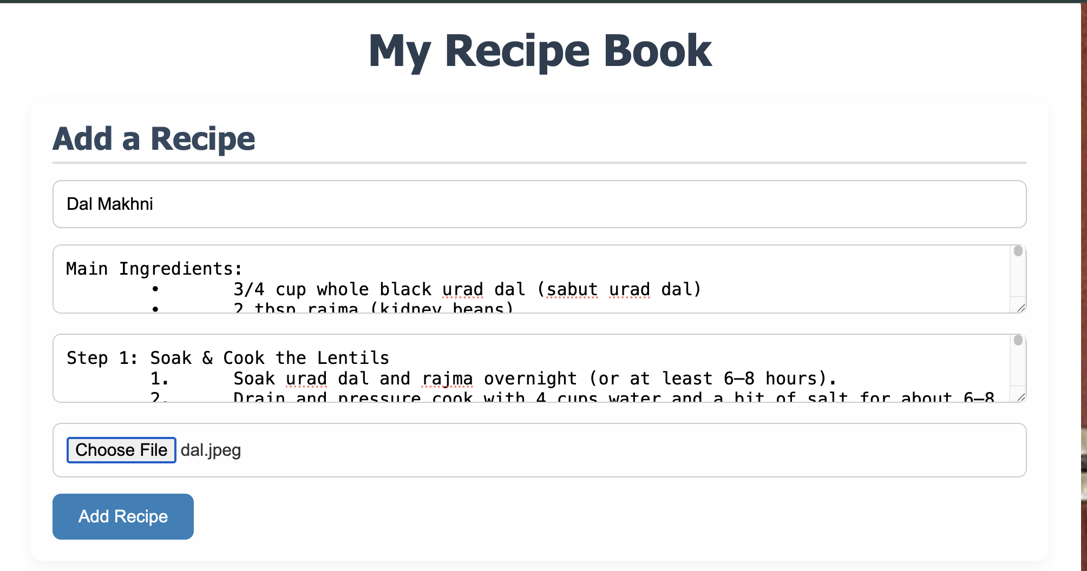
Add Recipe
Add Recipe

Slide 5
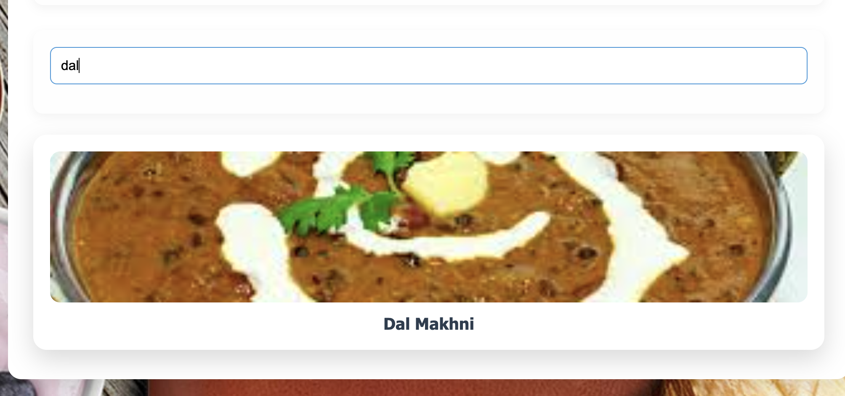
Search Recipe
Function:
Allows users to search
Fields:
• Recipe Name – Enter the dish name.
Action:
Press “Enter” to search
If present then will be shown
Search Recipe

Slide 6
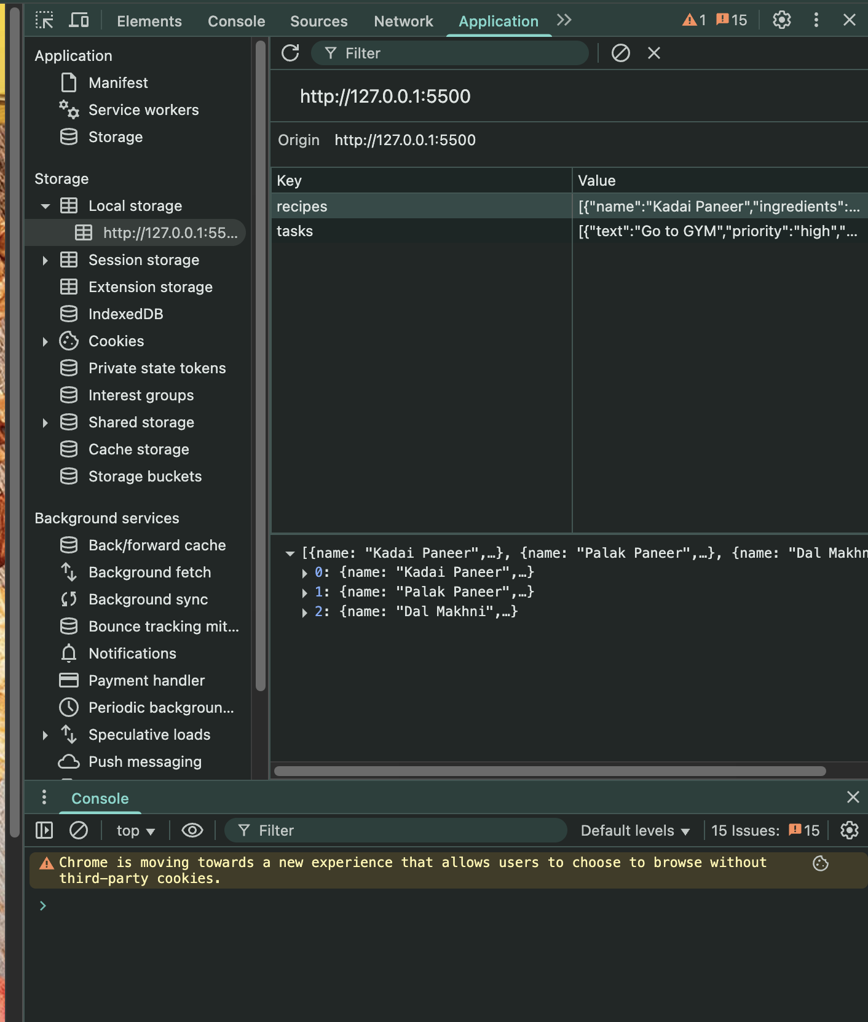
Local Storage
• 💾 Recipes are stored using the browser’s Local Storage.
• 🔄 Data persists even after reloading the page.
• ❌ You won’t lose recipes even if you close and reopen the browser.
• ✅ No internet or backend needed — everything is stored locally on your device.

